Slide 1
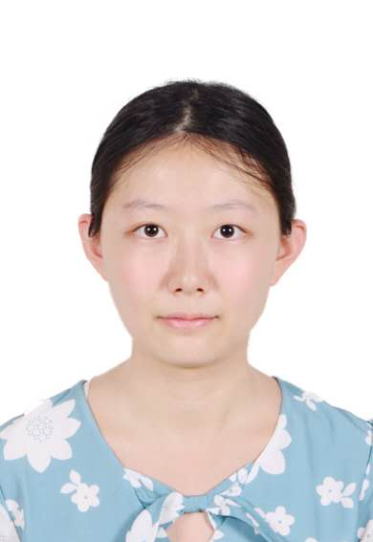
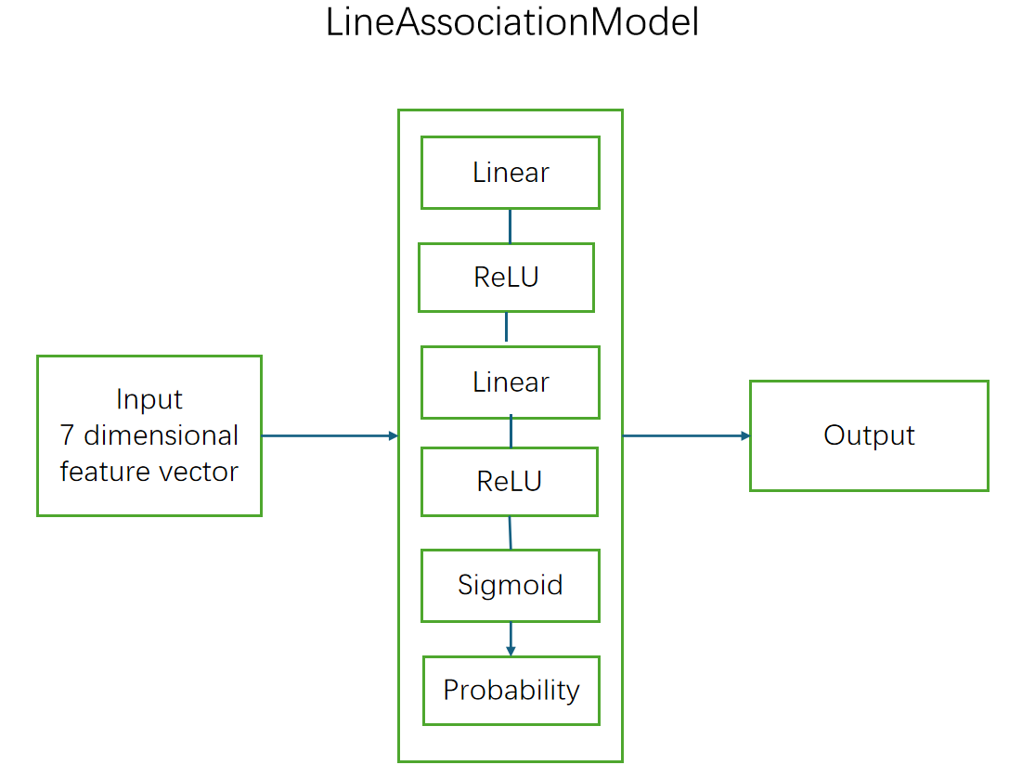
{insert profile picture}
Name: Zhang Jinjing, BSc student
Project type: laboratory project (önlab) Topic: Line association using neural network
Supervisors: Mrad Mohamed Azouz, Sik David
The goal of this project is to implement an association method for tracking line segments across consecutive video frames.
Each frame contains detected lane lines, and the task is to determine whether a line in frame 't+1' corresponds to one in frame 't'. A neural network is used to learn this association based on geometric features such as angle, length, and position.
The system is developed in Python using PyTorch and is compared against a classical rule-based approach in terms of accuracy and runtime. Training data is created automatically from the dataset using pseudo labels.
{insert picture/gif with setup or model architecture}

Slide 2
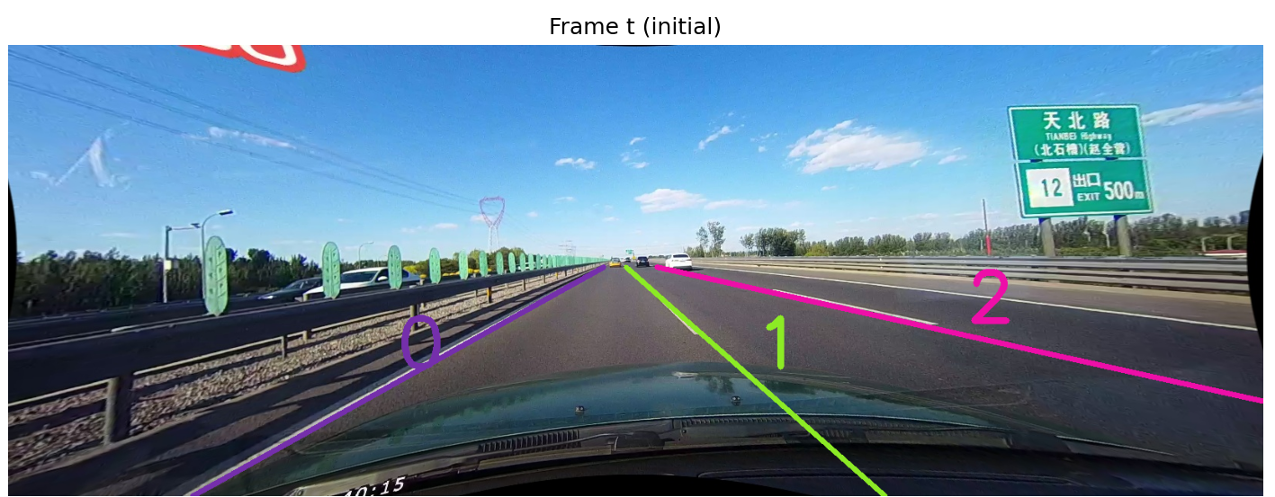
Experiments
At the begining ,we will initialize the lines from the first frame,assign them color and ID,and in the subsequent frames continuing to track these lines(and newly appeared lines)

Slide 3
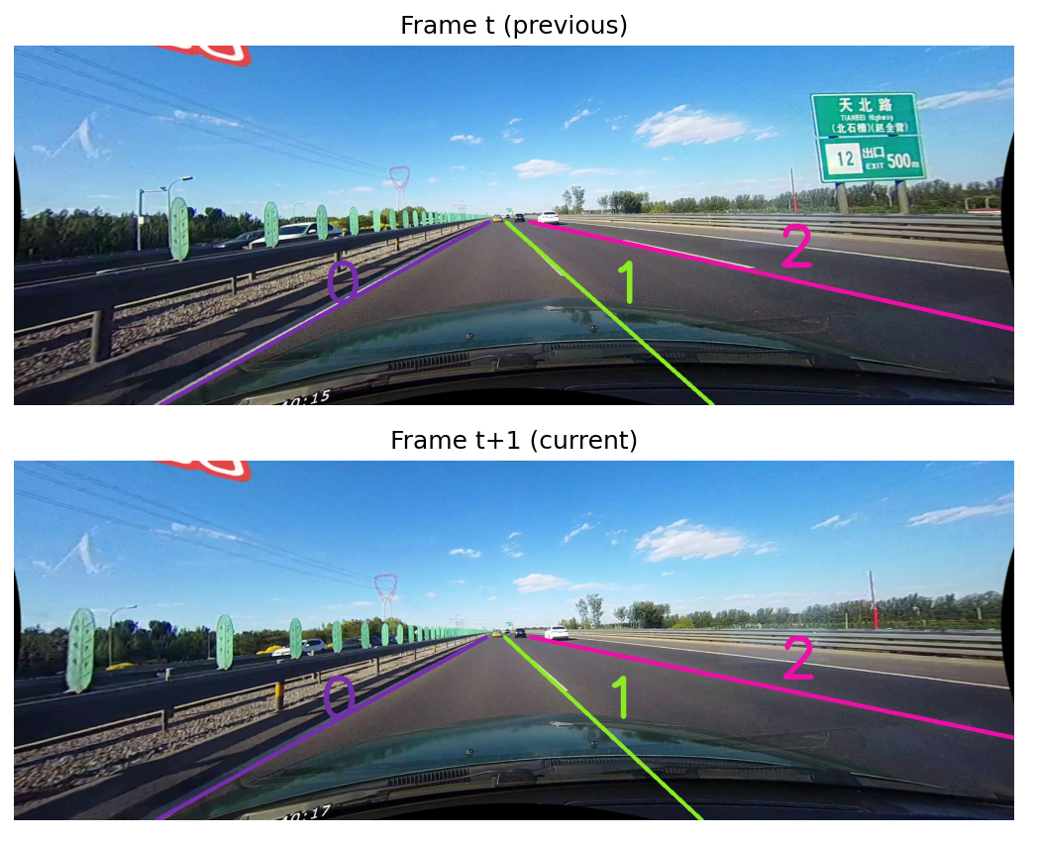
Experiments
The CULane dataset is used for training ,validation and testing. Line segments are extracted from each frame using provided annotation files (.lines.txt). Endpoints of each line are collected and converted to [x1, y1, x2, y2] format.
To train the association model, we construct 7-dimensional geometric features for each pair of lines between two consecutive frames. Positive and negative samples are automatically labeled using a rule-based classical matching algorithm.
The neural network is trained using binary cross-entropy loss and optimized with Adam optimizer. We monitor training accuracy and loss across epochs.
Both the classical and learned models are evaluated based on match accuracy and runtime. Inference is performed frame-by-frame, and matching results are visualized with color-coded IDs.
{insert picture/gif related to experiments}

Slide 4
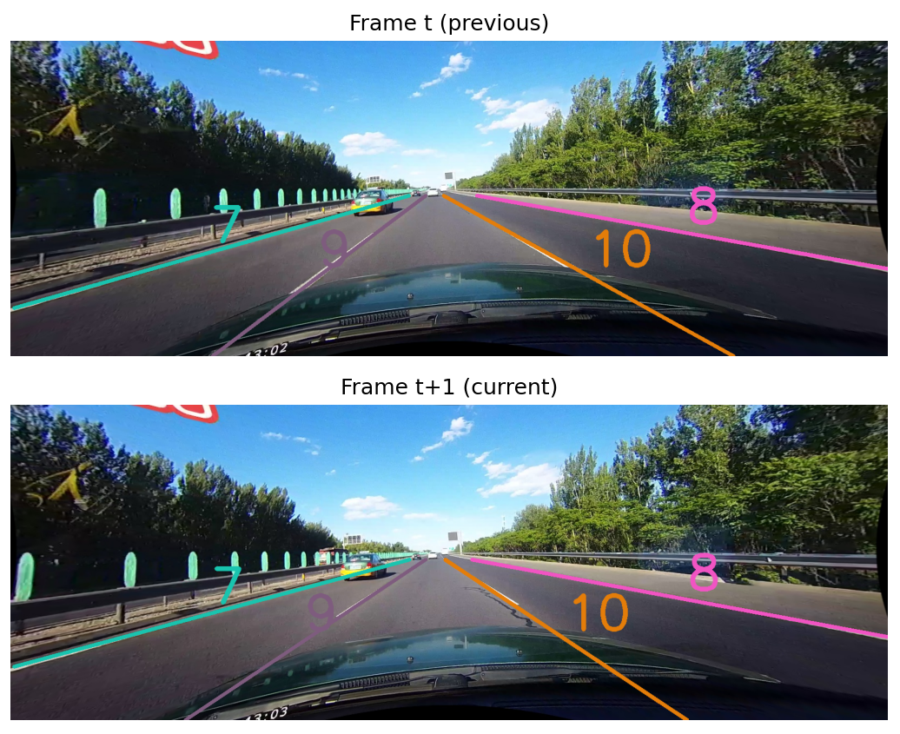
Experiments
In case a new line match appears it will also assign it new ID and color .

Slide 5
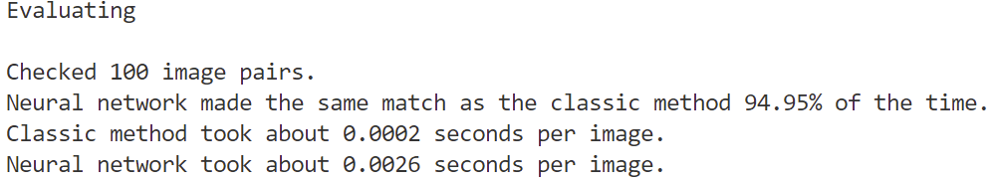
Results & future work
A neural matching model was developed and evaluated, achieving 94.95% of the accuracy of a traditional handcrafted method.
Future work should focus on improving model accuracy and speed through optimization techniques such as architecture refinement, knowledge distillation, or efficient inference frameworks.

